Slide 1


Slide 2
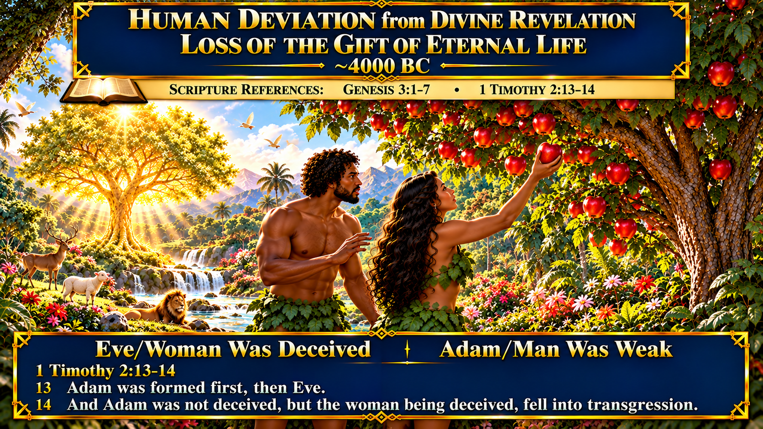

Slide 3
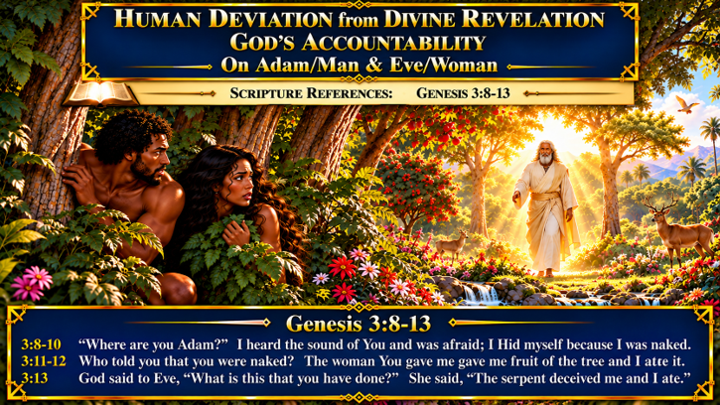

Slide 4
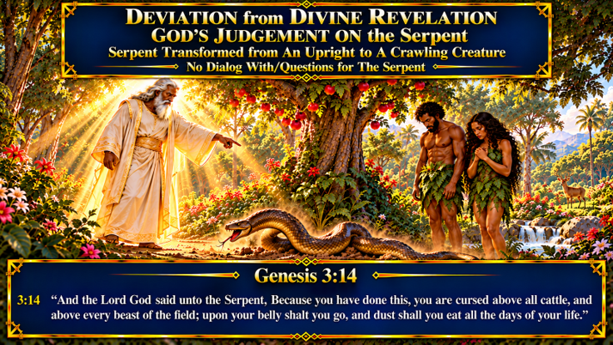

Slide 5
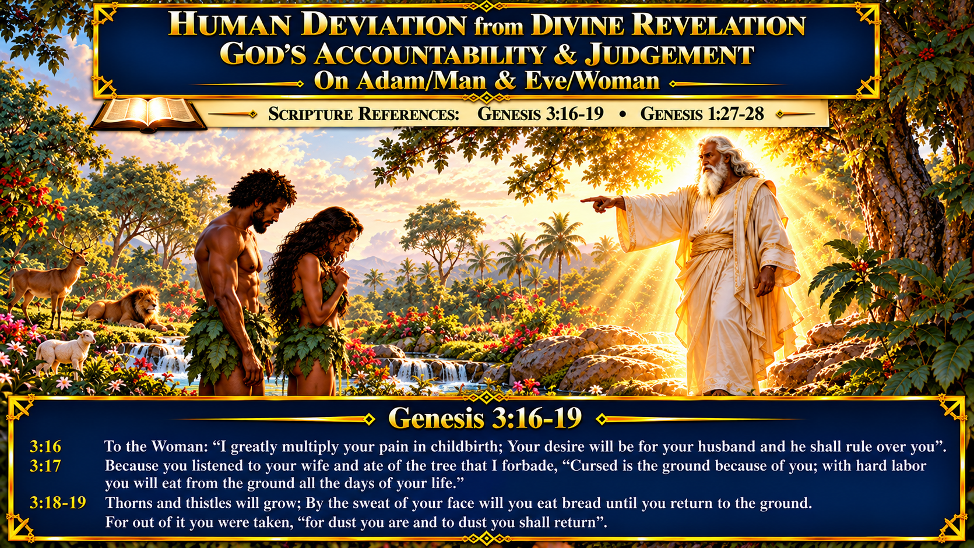

Slide 6
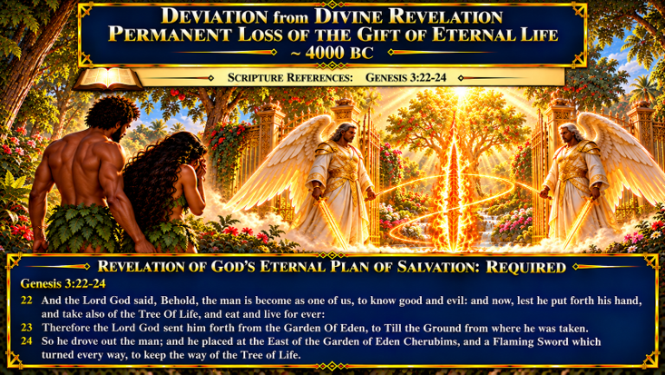

Slide 7
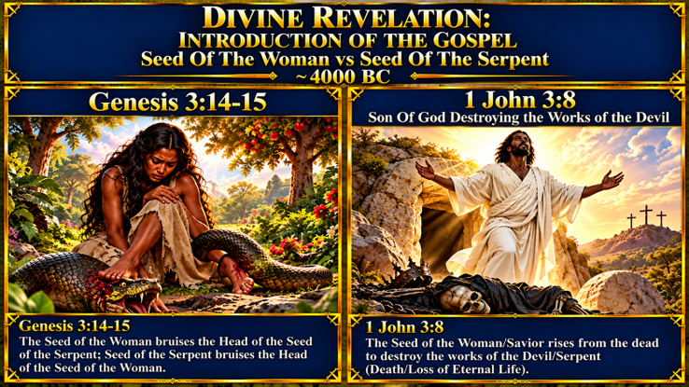

Slide 8


Lesson Summary
Genesis 1:1 God Created the World at ~ 4000 BC and inserted Human Time into Eternity where He God/Elohim already existed [Psalms 90:1-2]
God “Gifted Mankind With Eternal Life” and His Original Intent [OI] was for Mankind to Live Forever [Genesis 2:16-17; 3:22]
Mankind [Man & Woman, Adam & Eve] 1) committed Human Deviation from Divine Revelation 2) Violated the “Edenic Covenant”/Partook of the Tree of the Tree of the Knowledge of Good and Evil 3) Lost Eternal Life/Access to the Tree of Life
God “Foresaw” that Mankind would Transgress the Edenic Covenant and 1) Made the Eternal Plan of Salvation [2 Timothy 1:8-9, Titus 1:1-2, 2 Timothy1:8-9, Ephesians 1:3-5]
The 1) Eternal Plan of Salvation 2) Determinate Counsel and Foreknowledge of God was Divinely Revealed when the Gospel was Preached to Israel on Pentecost [Acts 2:22-24] and included all Gentile, non-Jewish Nations [Acts 2:38-39]

Slide 9
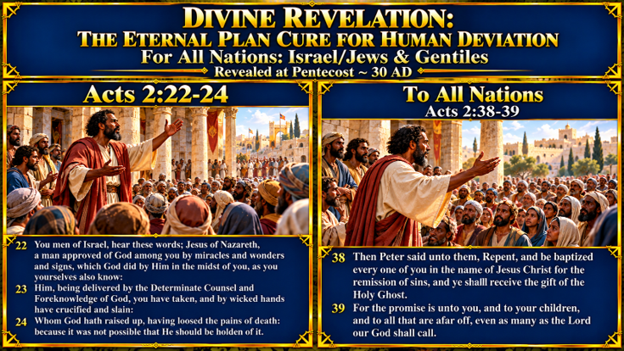

Slide 10


